Slide 1
Introduction to
Data Warehousing

Slide 2
Business Intelligence
”Set of Tools and Technologies for gathering, analyzing and providing access to data to Help enterprise users make better decisions.”

Slide 3
DW
A data warehouse can be considered as:
“ A repository providing access to integrated enterprise-wide data for management and decision support analysts. The information is subject orientated, recorded over time and may be stored at various degrees of summarization

Slide 4
Data Warehouse
A data warehouse is a De-Normalized DB
“subject-oriented, integrated, time-varying, non-volatile collection of data in support of the management's decision-making process.”

Slide 5

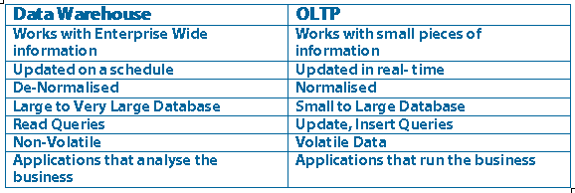
Notes:
OLTP Table normalised to Third Form
Contains entities, attributes, keys (primary, foreign etc), relationships
DW
Controlled redundancy – aids query response times

Slide 6


To summarize ...
OLTP Systems are
used to “run” a business
The Data Warehouse helps to “optimize” the business

Slide 7
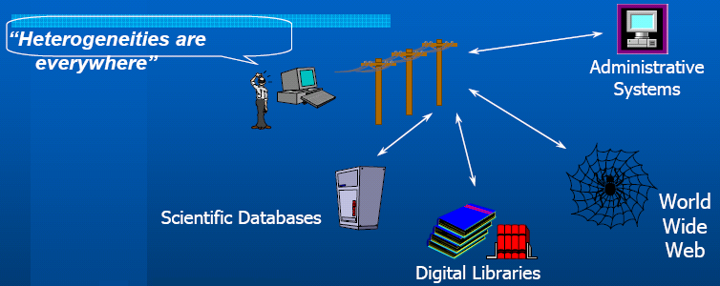
Heterogeneous Information Sources
Different interfaces
Different data representations
Duplicate and inconsistent information

Slide 8
Why OLAP
Slow-to-execute queries (0.1%)
General system slowdowns(Locking)
Manual query writing
Disparate data sources
Data is not available to all users

Slide 9
Data Warehousing and BI – Dimensional Modeling
Dimensional modeling is the design concept used by many data warehouse designers to build their data warehouse especially when BI is being planned
Dimensional Modeling is based on the star schema with a centralized fact table surrounded by smaller dimensional tables representing key scientific objects

Slide 10
Data Mining
Set of Algorithms used for predication, identification and discovering of hidden relations between data items, classification data by partitioning data into related categories to help decision makers.

Slide 11
-- Data Warehouse—Subject-Oriented
Organized around major subjects, such as customer, product, sales.
Focusing on the modeling and analysis of data for decision makers, not on daily operations or transaction processing.
Provide a simple and concise view around particular subject issues by excluding data that are not useful in the decision support process.
ADBS: DW

Slide 12
-- Data Warehouse—Integrated
Constructed by integrating multiple, heterogeneous data sources
  relational databases, flat files, on-line transaction records
Data cleaning and data integration techniques are applied.
  Ensure consistency in naming conventions, encoding structures, attribute measures, etc. among different data sources
ADBS: DW

Slide 13
-- Data Warehouse—Time Variant
The time horizon for the data warehouse is significantly longer than that of operational systems.
  Operational database: current value data.
  Data warehouse data: provide information from a historical perspective (e.g., past 5-10 years)
Every key structure in the data warehouse
  Contains an element of time, explicitly or implicitly
  But the key of operational data may or may not contain “time element”.
ADBS: DW

Slide 14
-- Data Warehouse—Non-Volatile
A physically separate store of data transformed from the operational environment.
Operational update of data does not occur in the data warehouse environment.
  Does not require transaction processing, recovery, and concurrency control mechanisms
  Requires only two operations in data accessing:
    Initial loading of data and access of data.
ADBS: DW

Slide 15
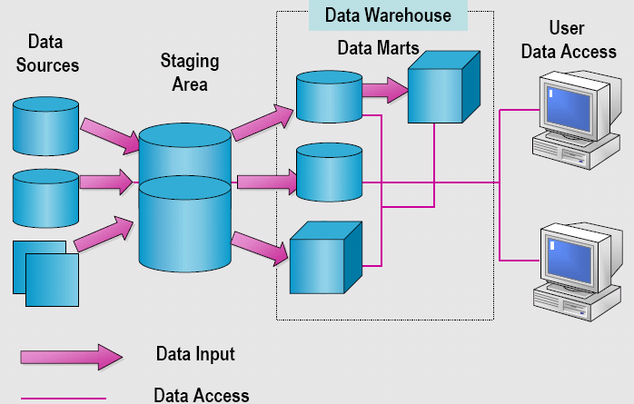
Data Warehouse System Components

Slide 16
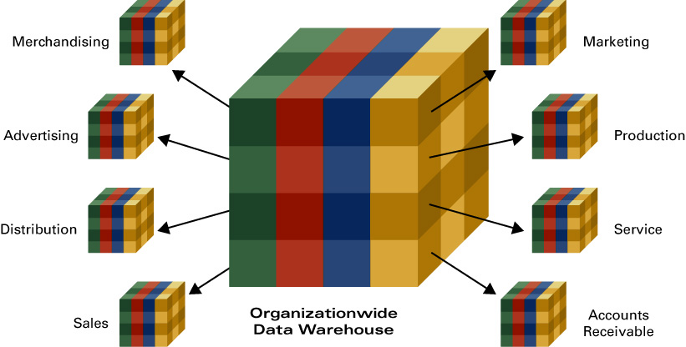
Data Marts
Miniature data warehouse
Has a special focus
Subset of a data warehouse
Aids decision making in a specific focus area
Notes:
A data mart is a miniature data warehouse with a special focus.
It’s essentially a data warehouse, in the sense that it gathers information from various locations, but it’s smaller, and focuses on one particular area like regional customer analysis.
Similarly, a data mart would usually be a subset of a data warehouse.
It would have information from a select set of databases to aid decision making in a specific focus area like one sales region of a national store chain.

Slide 17


Flat Files
Operational Systems
Marketing
Marketing
Sales
Finance
Human Resources
Sales
Data
Warehouse
Finance
Data Marts
External Data

Slide 18

Operational Systems
Flat Files
Sales or Marketing
External Data

Slide 19
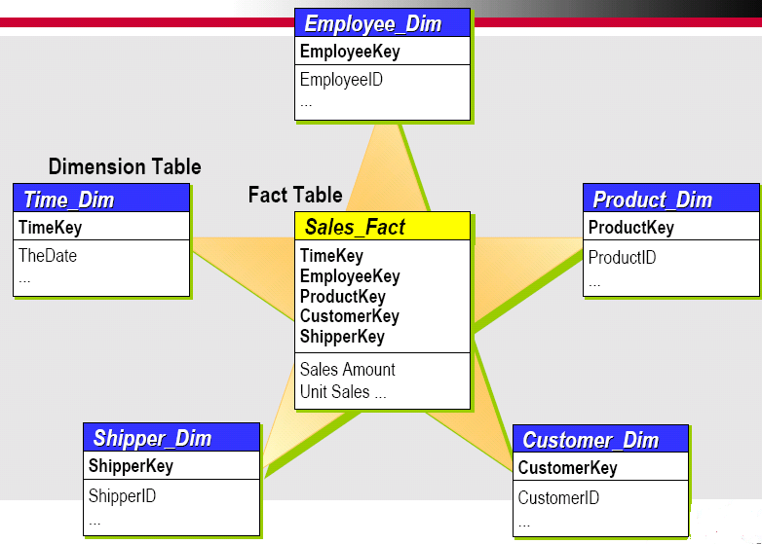
The Star Schema

Slide 20
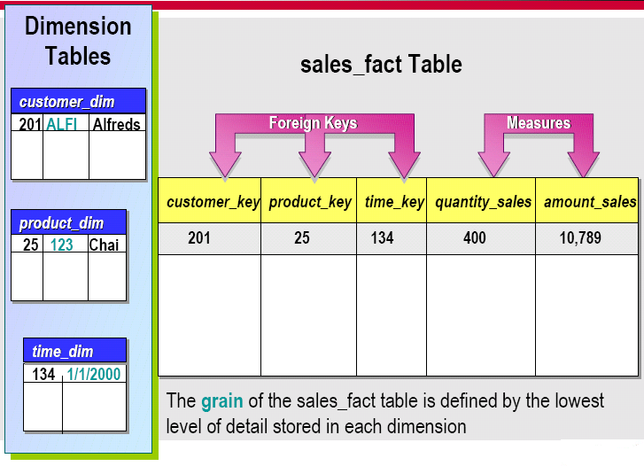
Fact Table Components

Slide 21
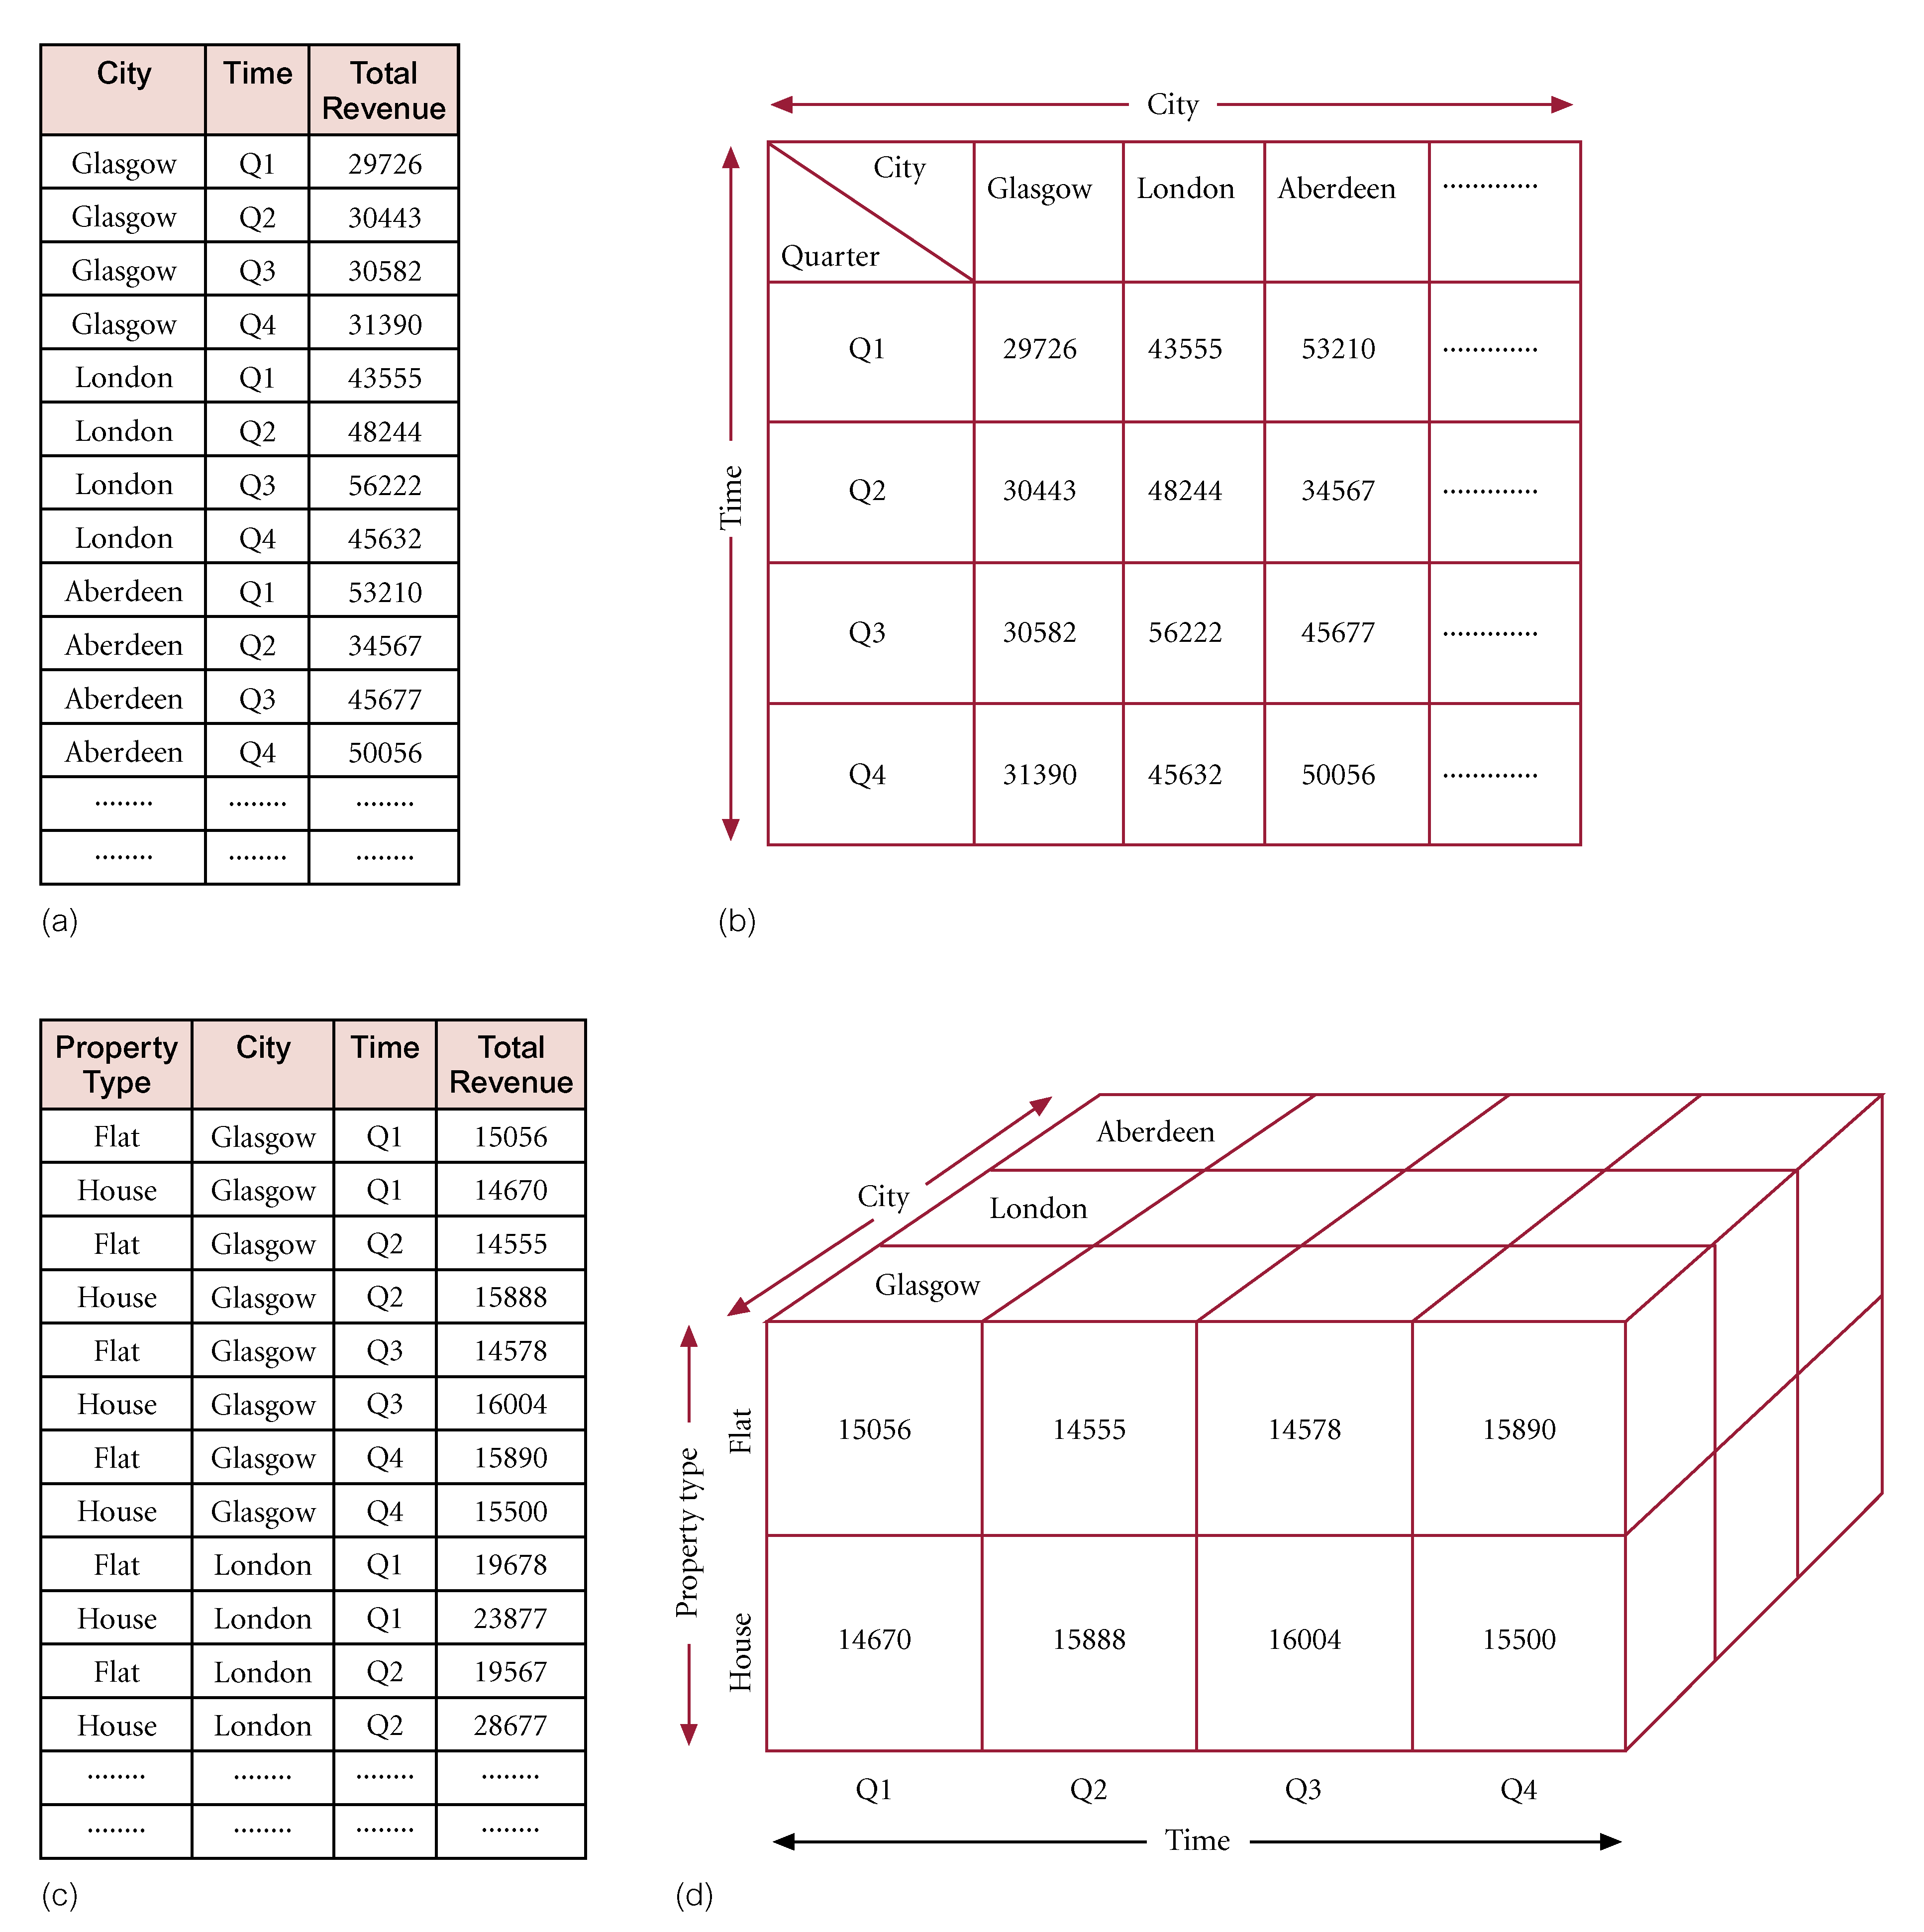
Two dimensions

Slide 22
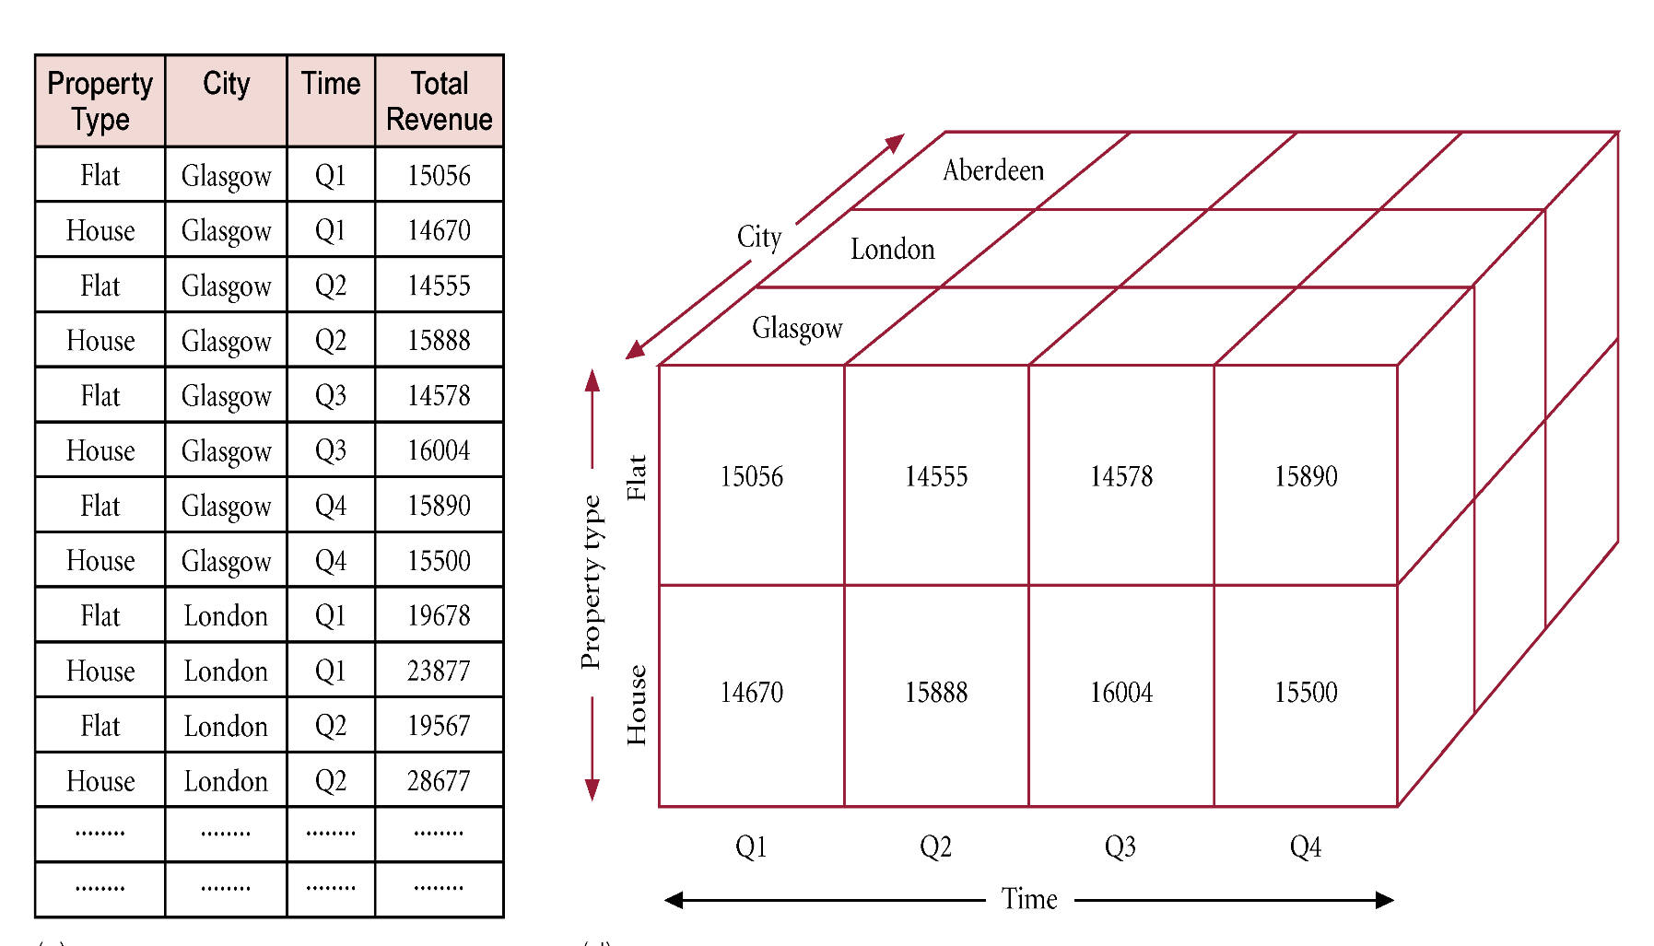
Three dimensions

Slide 23
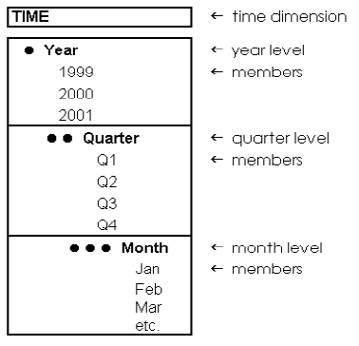
Dimension Fundamentals
Level of Granularity

Slide 24

all
all
region
Europe
...
North_America
country
Germany
...
Spain
Canada
...
Mexico
city
Frankfurt
...
Vancouver
...
Toronto
office
L. Chan
...
M. Wind
Han: Dataware Houses and OLAP

Slide 25
Relational Data Sources
Star and Snowflake Schemas
  Are required to build a cube with Analysis Services
Fact Table
  Contains measures
  Contains keys that join to dimension tables
Dimension Tables
  Must exist in same database as fact table
  Contain primary keys that identify each member

Slide 26
-- Multi-dimensional Schemas …
Modeling data warehouses: dimensions & measures
  Star schema: A fact table in the middle connected to a set of dimension tables
  Snowflake schema: A refinement of star schema where some dimensional hierarchy is normalized into a set of smaller dimension tables, forming a shape similar to snowflake
  Fact constellations: Multiple fact tables share dimension tables, viewed as a collection of stars, therefore called galaxy schema or fact constellation

Slide 27
--- Example of Star Schema
time
time_key
day
day_of_the_week
month
quarter
year
item
item_key
item_name
brand
type
supplier_type
Sales Fact Table
time_key
item_key
branch_key
branch
location
location_key
branch_key
branch_name
branch_type
location_key
street
city
province_or_street
country
units_sold
dollars_sold
avg_sales
Measures
ADBS: DW

Slide 28
--- Example of Snowflake Schema
time
item
time_key
day
day_of_the_week
month
quarter
year
item_key
item_name
brand
type
supplier_key
supplier
Sales Fact Table
supplier_key
supplier_type
time_key
item_key
branch_key
branch
location
location_key
location_key
street
city_key
branch_key
branch_name
branch_type
units_sold
city
dollars_sold
city_key
city
province_or_street
country
avg_sales
Measures
ADBS: DW

Slide 29
--- Example of Galaxy Schema
time
time_key
day
day_of_the_week
month
quarter
year
item
Shipping Fact Table
item_key
item_name
brand
type
supplier_type
Sales Fact Table
time_key
time_key
item_key
shipper_key
item_key
branch_key
from_location
branch
location_key
location
to_location
branch_key
branch_name
branch_type
units_sold
location_key
street
city
province_or_street
country
dollars_cost
dollars_sold
units_shipped
avg_sales
shipper
Measures
shipper_key
shipper_name
location_key
shipper_type
ADBS: DW

Slide 30
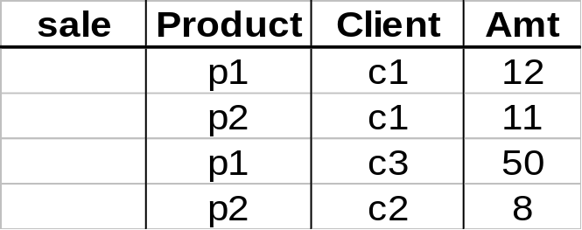
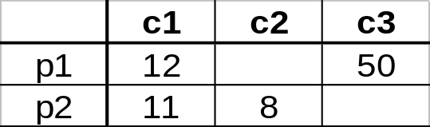
-- Data Cubes …
Fact relation
Two-dimensional cube
ADBS: DW

Slide 31
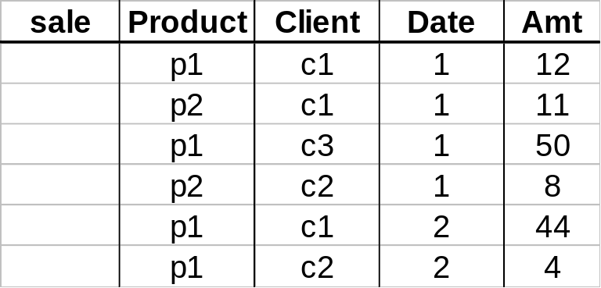
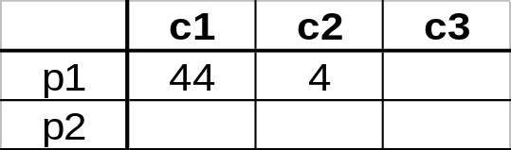
Data Cubes …
Fact relation
3-dimensional cube
day 2
day 1
ADBS: DW

Slide 32
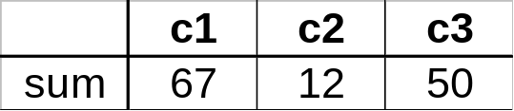
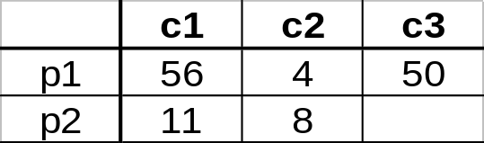
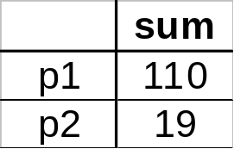
... -- Data Cubes …
Example: computing sums
day 2
. . .
day 1
129
ADBS: DW

Slide 33
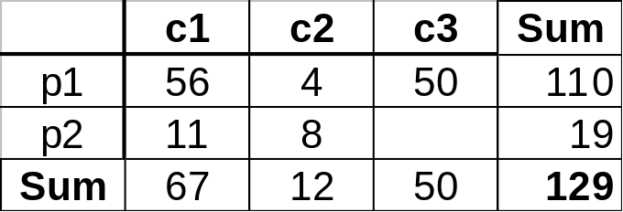
Data Cubes ...
In multidimensional data model together with measure values usually we store summarizing information (aggregates)
ADBS: DW

Slide 34
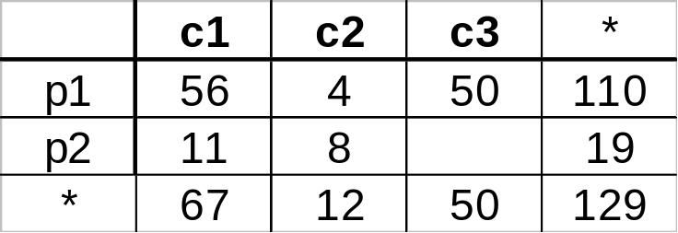
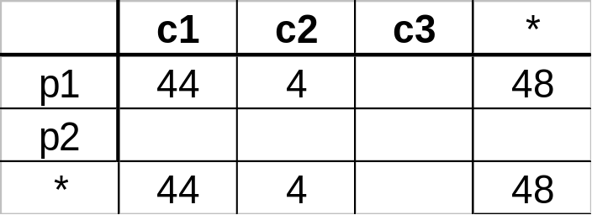
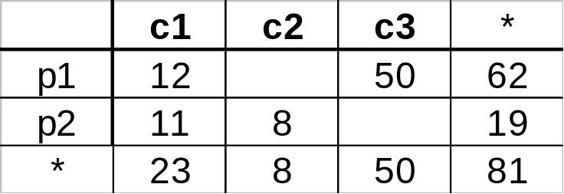
The Cube Operator …
*
day 2
sale(*,p2,*)
day 1
ADBS: DW

Slide 35


Date
Total annual sales
of TV in K. S. A.
1Qtr
2Qtr
3Qtr
4Qtr
sum
Product
TV
PC
K.S.A
VCR
sum
U.A.E.
Country
Bahrain
sum
All, All, All
ADBS: DW

Slide 36
-- The Cube Operator …
day 2
. . .
day 1
sale(c1,*,*)
129
sale(c2,p2,*)
sale(*,*,*)
ADBS: DW

Slide 37
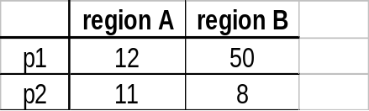
-- Aggregation Using Hierarchies …
day 2
customer
day 1
region
country
(customer c1 in Region A;
customers c2, c3 in Region B)
ADBS: DW

Slide 38
-- OLAP Queries: Roll Up
Summarizes data along dimension.
client
c1
10
3
21
Dammam
c2
12
5
9
city
c3
11
7
7
Riyadh
12
11
15
Date of sale
region
c4
video
CD
Camera
Roll up
aggregation with respect to city
 | Video | Camera | CD
Dammam | 22 | 8 | 30
Riyadh | 23 | 18 | 22
ADBS: DW

Slide 39
OLAP Queries: Drill down
day 2
day 1
129
rollup
drill-down
ADBS: DW

Slide 40
Data Analysis
How does SSAS Store this Data?
MOLAP
  records both data and summary values in Analysis Services proprietary file format (Most Efficient) At the end it is an object class
ROLAP
  records both data and aggregations in a relational database.
HOLAP
  stores data in a relational database while aggregations are stored in multidimensional format.

Slide 41
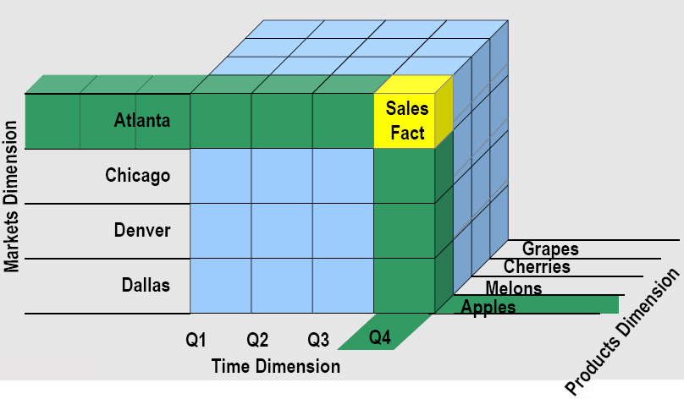
Querying a Cube (MDX)

Slide 42
Querying a DM (DMX)

Slide 43
Administration and DDL for cube (XMLA)
Notes:
Backup and restore and security

Slide 44
Data Presentation
  Using Excel pivot tables and more
  Using SQL Server Reporting Services (SSRS)
  Understanding SharePoint Web parts
  Reporting tools (Crystal Reports)
  3rd Party tools (ProClarity)
  Performance Point Server
  C#,Asp.Net Report viewer

